Slide 1
Understanding ROS Nodes and Topics

Slide 2
Understanding ROS Topics
http://wiki.ros.org/ROS/Tutorials/UnderstandingTopics

Slide 3
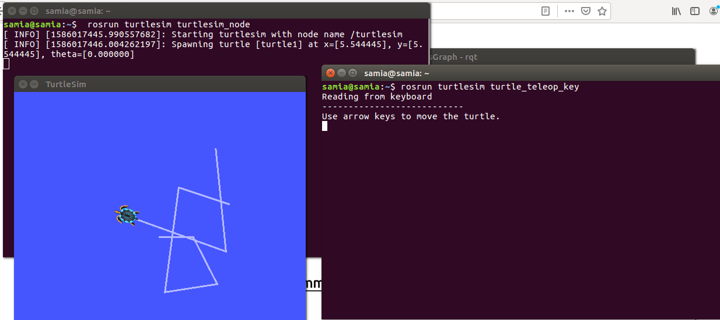
Run roscore / trutlesim/ turtlesimteleopkey
The turtlesim_node and the turtle_teleop_key node are communicating with each other over a ROS Topic. turtle_teleop_key is publishing the key strokes on a topic, while turtlesim subscribes to the same topic to receive the key strokes.

Slide 4
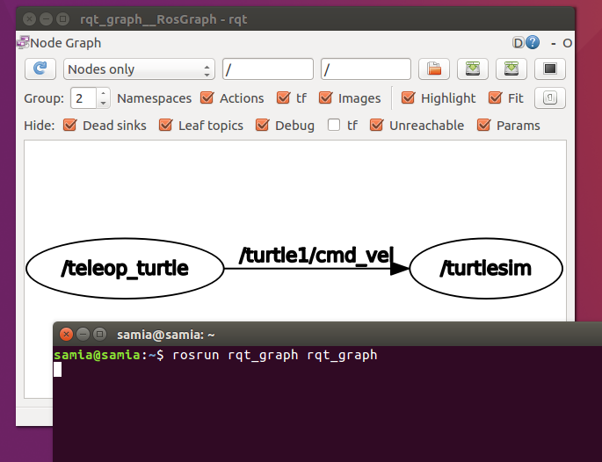
rqt_graph
rqt_graph creates a dynamic graph of what's going on in the system. rqt_graph is part of the rqt package.

Slide 5
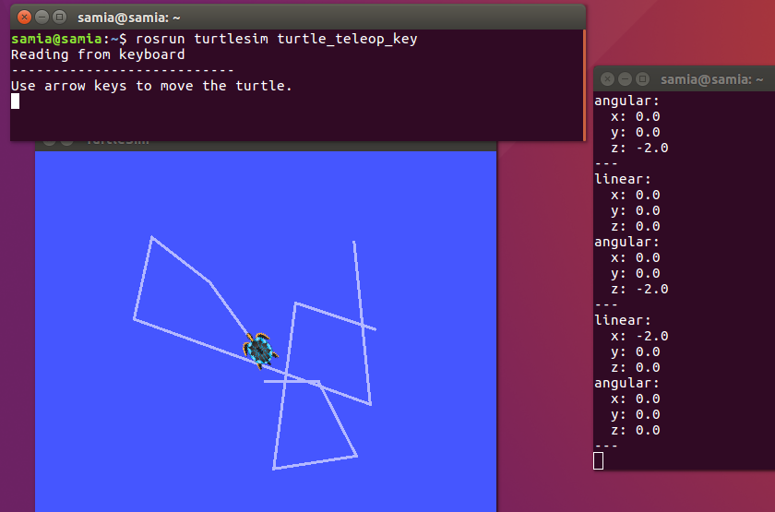
rostopic
Using rostopic echo
$ rostopic echo /turtle1/cmd_vel

Slide 6
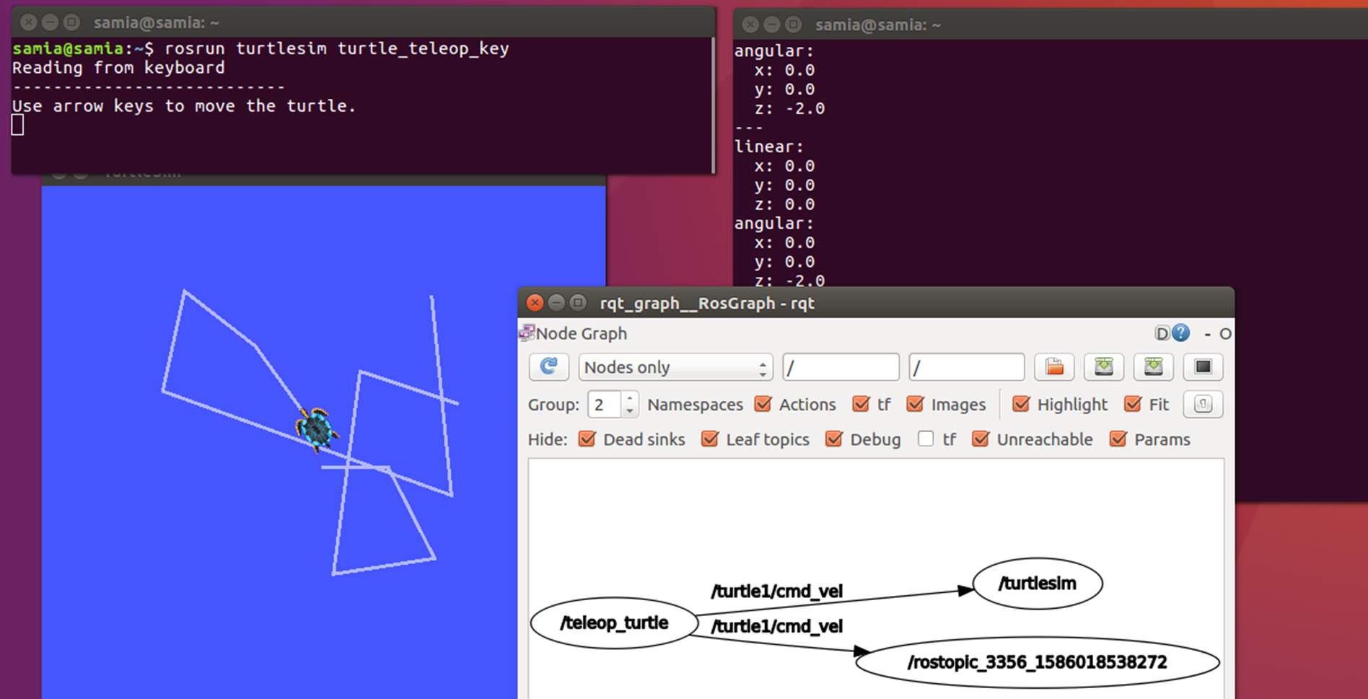
See changes in the rqt graph

Slide 7
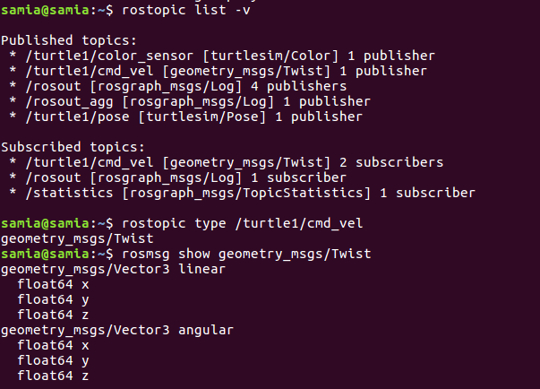
Rostopic type

Slide 8
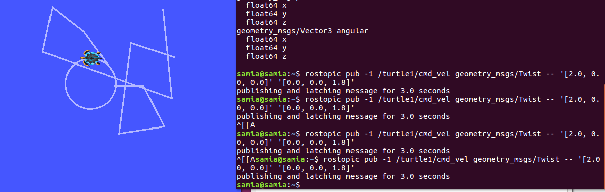
rostopic pub publishes data on to a topic currently advertised.
rostopic pub [topic] [msg_type] [args]

Slide 9
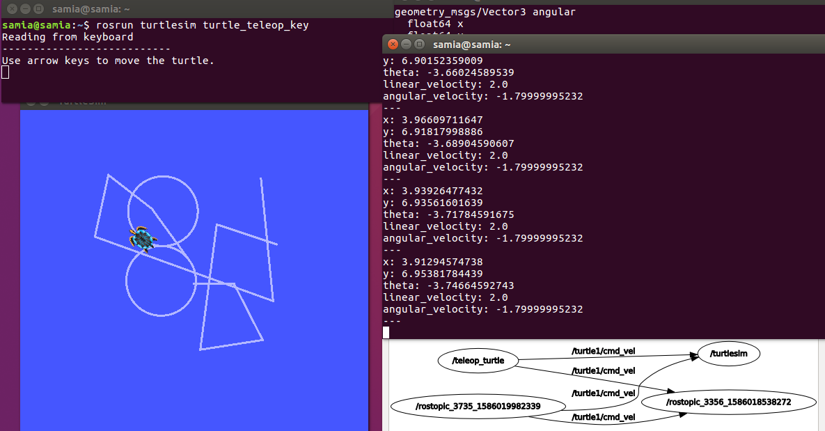
rostopic pub /turtle1/cmd_vel geometry_msgs/Twist -r 1 -- '[2.0, 0.0, 0.0]' '[0.0, 0.0, -1.8]'

Slide 10
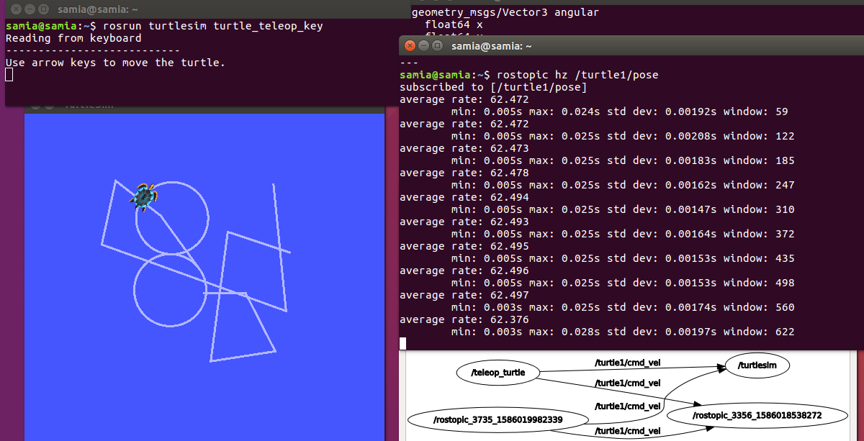
rostopic hz reports the rate at which data is published.

Slide 11
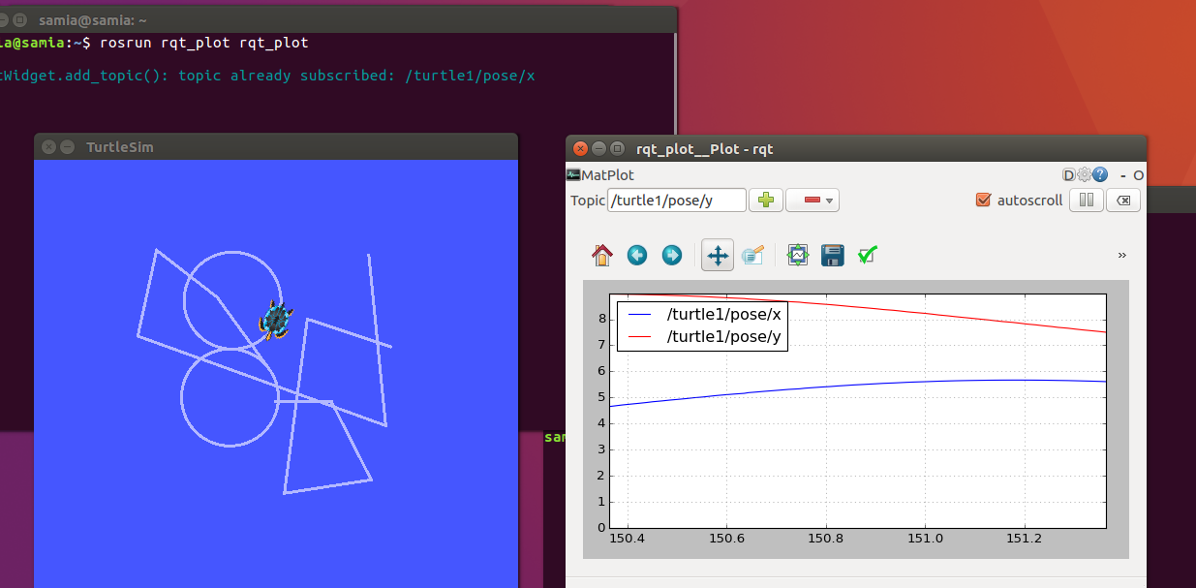
Plot the position x and y

Slide 12
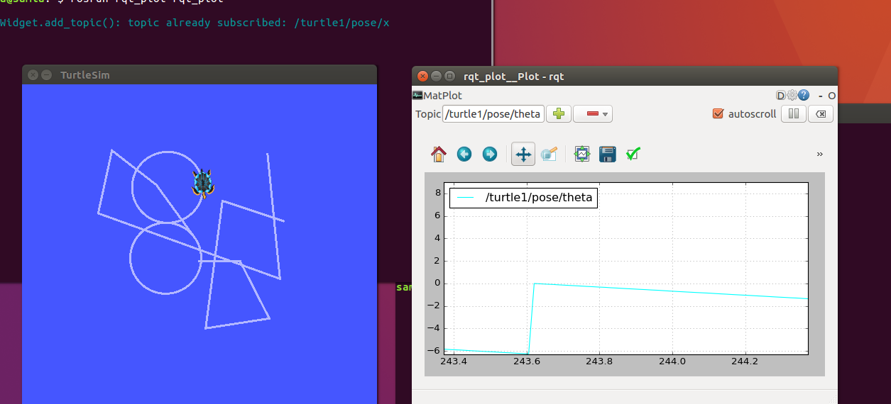
Plot the angle theta

Slide 13
Understanding ROS Services and Parameters
http://wiki.ros.org/ROS/Tutorials/UnderstandingServicesParams

Slide 14
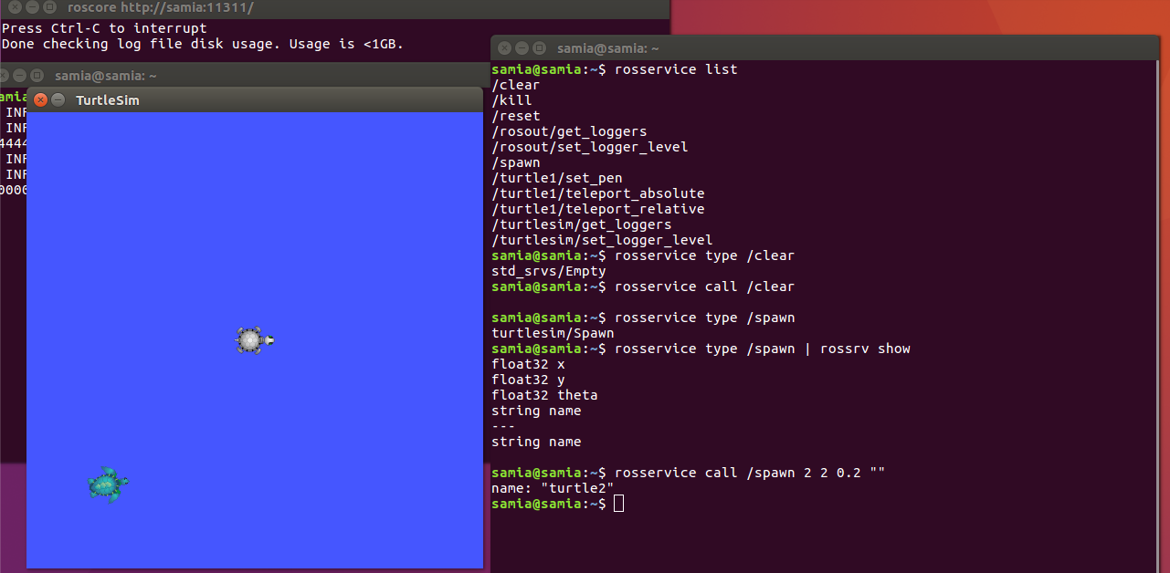
ROS Services Services are another way that nodes can communicate with each other. Services allow nodes to send a request and receive a response.

Slide 15
Using rosparam
rosparam allows you to store and manipulate data on the ROS Parameter Server. The Parameter Server can store integers, floats, boolean, dictionaries, and lists. rosparam uses the YAML markup language for syntax. In simple cases, YAML looks very natural: 1 is an integer, 1.0 is a float, one is a string, true is a boolean, [1, 2, 3] is a list of integers, and {a: b, c: d} is a dictionary. rosparam has many commands that can be used on parameters, as shown below:
Usage:
rosparam set set parameter
rosparam get get parameter
rosparam load load parameters from file
rosparam dump dump parameters to file
rosparam delete delete parameter
rosparam list list parameter names

Slide 16
